Slide 1
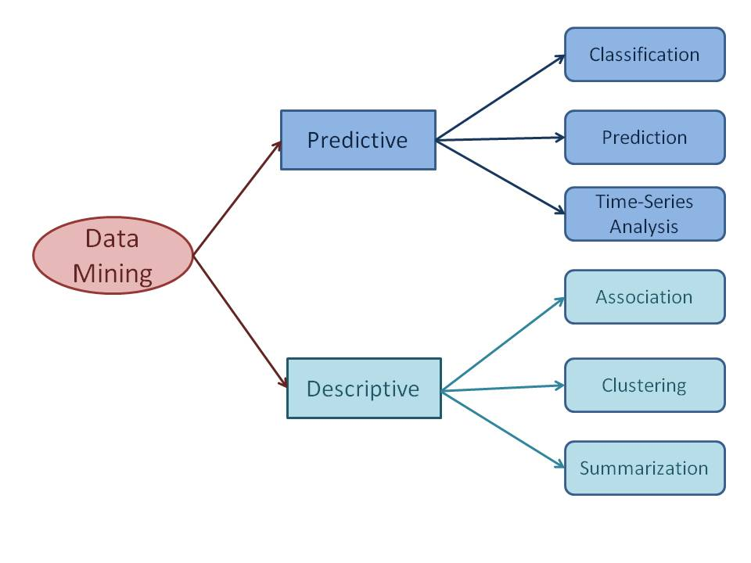

Slide 2
Descriptive Data Mining:
It includes certain knowledge to understand what is happening within the data without a previous idea. The common data features are highlighted in the data set. For examples: count, average etc.
2.Predictive Data Mining:
It helps developers to provide unlabeled definitions of attributes. Based on previous tests, the software estimates the characteristics that are absent. For example: Judging from the findings of a patient’s medical examinations that is he suffering from any particular disease.

Slide 3
Predictive data mining tasks come up with a model from the available data set that is helpful in predicting unknown or future values of another data set of interest.
A medical practitioner trying to diagnose a disease based on the medical test results of a patient can be considered as a predictive data mining task.
Descriptive data mining tasks usually finds data describing patterns and comes up with new, significant information from the available data set. A retailer trying to identify products that are purchased together can be considered as a descriptive data mining task.

Slide 4
Classification
Classification derives a model to determine the class of an object based on its attributes. A collection of records will be available, each record with a set of attributes. One of the attributes will be class attribute and the goal of classification task is assigning a class attribute to new set of records as accurately as possible.
Classification can be used in direct marketing, that is to reduce marketing costs by targeting a set of customers who are likely to buy a new product. Using the available data, it is possible to know which customers purchased similar products and who did not purchase in the past. Hence, {purchase, don’t purchase} decision forms the class attribute in this case. Once the class attribute is assigned, demographic and lifestyle information of customers who purchased similar products can be collected and promotion mails can be sent to them directly.

Slide 5
b) Prediction
Prediction task predicts the possible values of missing or future data. Prediction involves developing a model based on the available data and this model is used in predicting future values of a new data set of interest.
For example, a model can predict the income of an employee based on education, experience and other demographic factors like place of stay, gender etc. Also prediction analysis is used in different areas including medical diagnosis, fraud detection etc.

Slide 6
c) Time - Series Analysis
Time series is a sequence of events where the next event is determined by one or more of the preceding events.
Time series reflects the process being measured and there are certain components that affect the behavior of a process.
Time series analysis includes methods to analyze time-series data in order to extract useful patterns, trends, rules and statistics. Stock market prediction is an important application of time- series analysis.

Slide 7
d) Association
Association discovers the association or connection among a set of items.
Association identifies the relationships between objects. Association analysis is used for commodity management, advertising, catalog design, direct marketing etc.
A retailer can identify the products that normally customers purchase together or even find the customers who respond to the promotion of same kind of products. If a retailer finds that beer and nappy are bought together mostly, he can put nappies on sale to promote the sale of beer.

Slide 8
e) Clustering
Clustering is used to identify data objects that are similar to one another. The similarity can be decided based on a number of factors like purchase behavior, responsiveness to certain actions, geographical locations and so on.
For example, an insurance company can cluster its customers based on age, residence, income etc. This group information will be helpful to understand the customers better and hence provide better customized services.

Slide 9
f) Summarization
Summarization is the generalization of data. A set of relevant data is summarized which result in a smaller set that gives aggregated information of the data.
For example, the shopping done by a customer can be summarized into total products, total spending, offers used, etc. Such high level summarized information can be useful for sales or customer relationship team for detailed customer and purchase behavior analysis.
Data can be summarized in different abstraction levels and from different angles.

Slide 10
INTERESTING PATTERN
Interestingness measures play an important role in data mining, regardless of the kind of patterns being mined.
These measures are intended for selecting and ranking patterns according to their potential interest to the user.
Good measures also allow the time and space costs of the mining process to be reduced.

Slide 11
MEASURES OF PATTERNS INTERESTINGNESS
There are subjective as well as objective measures of patterns interestingness as :
1] Objective Measures
(a)Support Threshold
(b)Confidence Threshold
(c)Correlation Coefficient
2] Subjective Measures
(a)User Belief and Expectations
(b) User Need

